Slide 1

Modelling
Persistency of a drug
Team : OpenML
Members : - Juan Carlos
- Laith Adi
- Gerson Orihuela
- Walquer Valles
Date : 15-May-2021

Slide 2
Agenda
Business Problem
Decision Tree Model
Random Forest Model
Logistic Regression Model
SVM Model
Conclusions
App Concept Test

Slide 3
Business problem
ABC Pharma contacted us to carry out an analysis in order to have a deeper understanding on the factors impacting the persistence of their drug. The aim is to know if a patient, based on his/her information, will follow the prescription of the physician and continue taking the drug for all the treatment time.

Slide 4
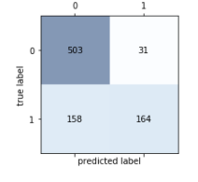
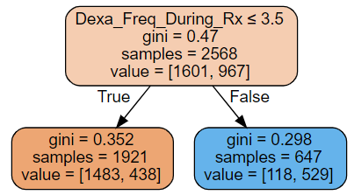
Decision tree
model
Decision tree model was used, the best scores corresponded with a tree of depth 1. the results are the following:
- 78% accuracy was obtained for training data.
- 77% accuracy was obtained for testing data.
The results for the confusion matrix are the following:
Dexa_Freq_During_Rx is clearly the variable that has the most value in terms of predictive power. It could be interesting to see if we can get similar results without it. Take into account the Dexa_Freq_During_Rx is kind of another type of treatment. So it would be interesting to be able to predict persistence without it.

Slide 5
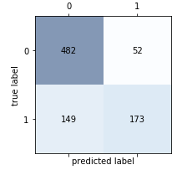
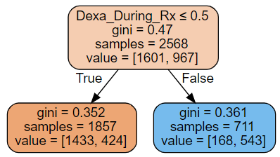
Decision tree
model
What if we drop Dexa_Freq_During_Rx?
A tree of depth 1 was obtained. the results are the following:
76% accuracy was obtained for training data.
76% accuracy was obtained for testing data.
Dexa_During_Rx is a pretty similar to Dexa_Freq_During_Rx. We suppose they refer to the same treatment.

Slide 6
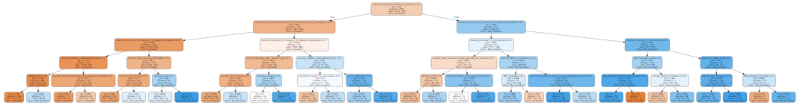
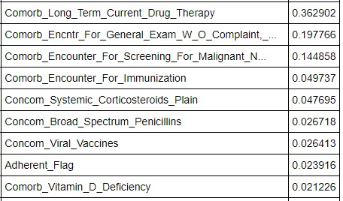
Decision tree
model
Without Dexa_Freq_During_Rx and Dexa_During_Rx, comorbidity factors appear as important predictors in a tree of depth 5.
The following chart shows the variables aside from Dexa_Freq_During_Rx and Dexa_During_RX in order of predictive power of persistence in taking the drug.

Slide 7
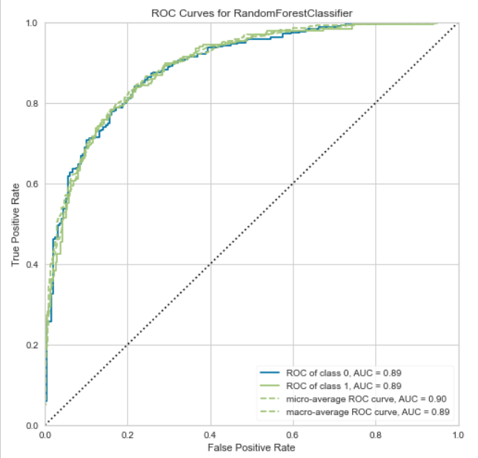
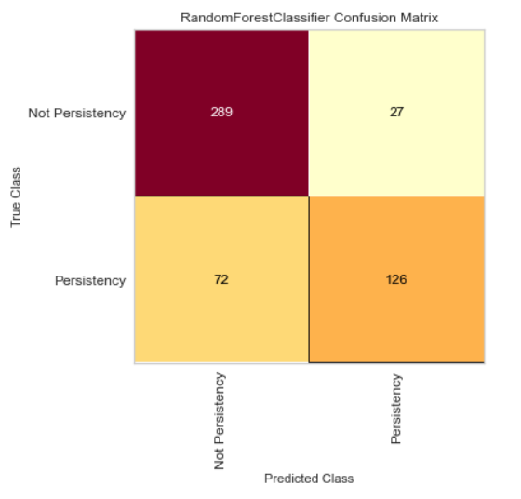
Random Forest Model
Using the chi-square statistic, some variables were eliminated. For the modelling, Random Forest model was used and the results are the following:
88% accuracy was obtained for training data.
80% accuracy was obtained for testing data.
The results for the confusion matrix and the curve ROC in the testing data are the following:

Slide 8
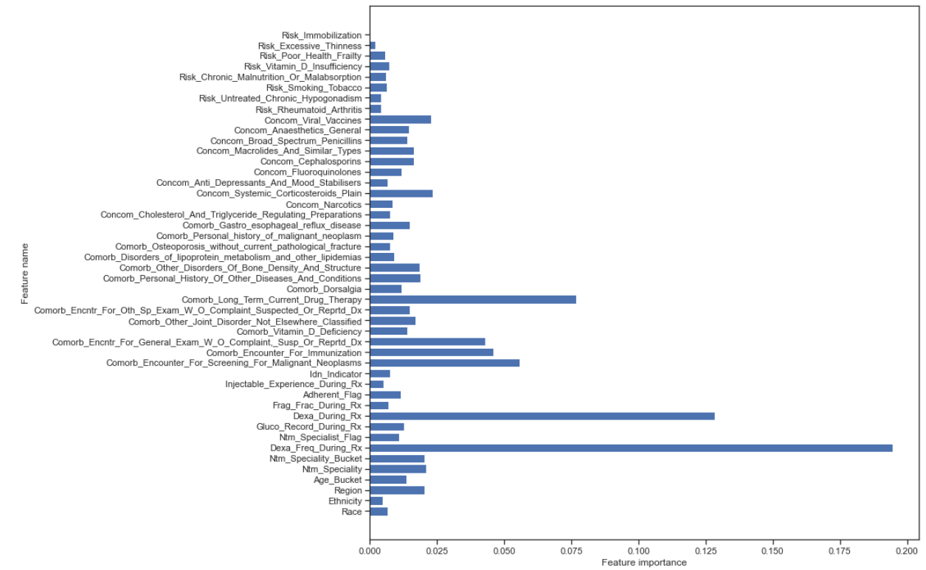
Random Forest Model
The influence of the variables on the target variable is shown in the following image:
The Dexa_freq_during_rx, Dexa_During_RX and Comorb_Long_Term_Current_Drug_Therapy are the most influential.

Slide 9
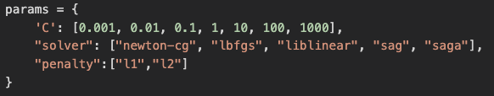
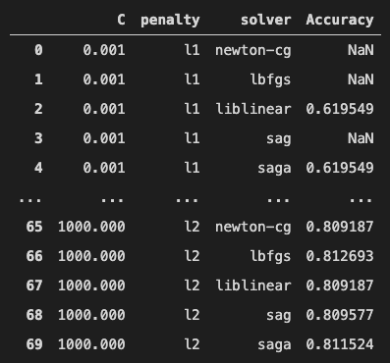
Logistic Regression Model
The following screenshot (top) displays the different parameter and their values when using exhaustive search (GridSearchCV) for tuning the hyperparameters.
The bottom screenshot displays the different combinations of set hyperparameters and the resulting accuracy when using GridSearchCV. Next slide the best parameters and score will be shown.

Slide 10
Logistic Regression Model
The following are the best parameters and score, based on accuracy, from the GridSearchCV API from Sk-Learn.
These results are based on the fitting of the training sets.

Slide 11
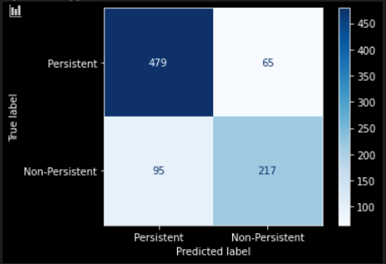
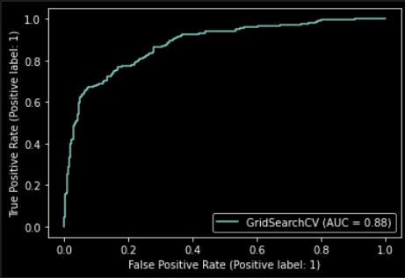
Logistic Regression Model
f1 score is used to evaluate the logistic regression model. Along with the confusion matrix and ROC curve.
f1 score: 0.81087
Confusion matrix
ROC curve

Slide 12
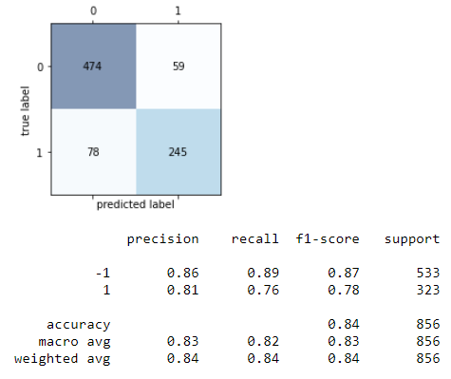
SVM
Model
Support Vector Machines algorithm to classify the persistence of patients (1 for positives and -1 for negatives). A linear kernel has been used, obtaining an accuracy of 83.5 % over testing data (25 % out of the whole dataset).

Slide 13
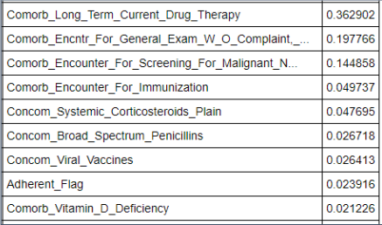
Conclusions
The Dexa_freq_during_rx, is the variable with greater power to predict persistent and non-persistent results. This variable if followed in impontance by Dexa_During_RX and Comorb_Long_Term_Current_Drug_Therapy.
After those the following chart summarize the importance of other variables to predict the target variable.
The best model to be used to make predictions is the SVM model with 83.5 % of accuracy.

Slide 14
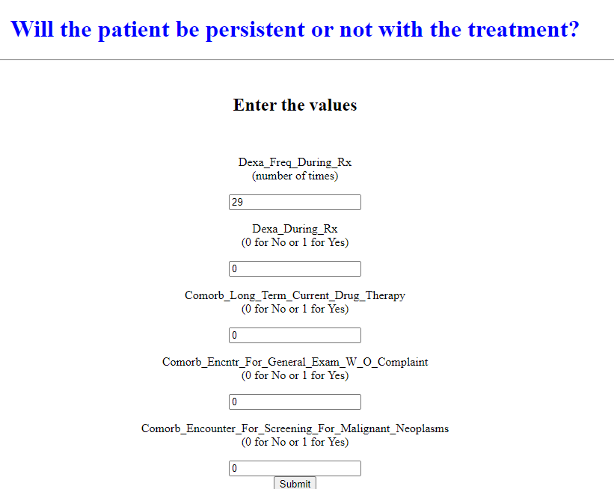
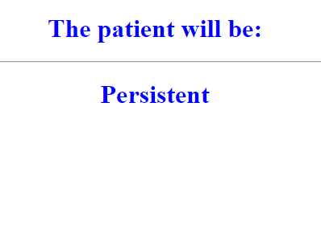
App Concept Test
Go to https://drug-persistence-app.herokuapp.com/ to check a version of the App with the 5 most important predictors at an 78.27% of accuracy in the prediction.

Slide 15
Thank You

